Slide 1
"
Can reading
the news help
you beat
the market?
📱 Tech (XLK)
Event-driven
Earnings · AI · Regulation
🏦 Finance (XLF)
Macro-driven
Rates · Cycles · Policy
5 years · 1,010 trading days · NYT news data
1

Slide 2
Why Does News Move Stock Prices?
Grounding the model in investor behaviour theory (Fishbein & Ajzen, 1975)
ATTITUDE
= Sentiment Score
Bullish or Bearish?
AWARENESS
NYT news article published
PERCEPTION
Investor reads and interprets
INTENTION
Decision to buy or sell
BEHAVIOUR
Stock price
direction ↑↓
→
→
→
→
📱 XLK — Technology (Retail-driven)
Retail investors need days to read,
process and act on news.
Attitude → Behaviour lag: 1–4 days
✔ Predictable window exists
Granger: 6 features significant (lags 1–4d)
🏦 XLF — Financial (Institution-driven)
Algorithms execute in milliseconds.
Attitude and Behaviour happen simultaneously.
No exploitable lag.
✘ No predictable window
Granger: 0 features significant
2

Slide 3
We built it from scratch.
No pre-trained black box. Four custom sentiment classifier pipelines trained on financial news. | ETF selection: XLK & XLF chosen as the two largest sector ETFs by AUM — top 10 constituent companies used as holdings-based keywords for article collection. | Technical details: see Appendix
1
2
3
4
Sparse NB
Dense SVM
LDA+XGB
Word2Vec
TF-IDF
+ Naive Bayes
TF-IDF + SVD
+ SVM
Topic model
+ XGBoost
Embeddings
+ XGBoost
85%
89%
79%
80%
accuracy
accuracy
accuracy
accuracy
★ WINNER
Dense SVM selected for all downstream sentiment scoring
3

Slide 4
Two Hypotheses
What are we testing? What would it mean if true?
H1
H2
Sector Divergence
Sentiment Value
XLK (Technology) achieves higher directional prediction accuracy from news sentiment than XLF (Financial).
Adding news sentiment features significantly improves directional prediction accuracy beyond technical indicators alone.
Why it would matter:
Why it would matter:
Different sectors respond differently to news — NLP strategies should not be applied uniformly across all stocks.
Justify the cost and complexity of building a full NLP pipeline — would it actually improve trading decisions?
"H1 tested: paired t-test, n=1,010 | Results: Slides 5 | H2 tested: McNemar's test, 80/20 split | Results: Slides 11"
4

Slide 5
The Performance Gap
It depends on which sector you're looking at.
H1: XLK more sentiment-predictable than XLF? → Tested here H2: Does adding sentiment improve accuracy? → Answer on Slide 11
📱 XLK (Tech)
🏦 XLF (Finance)
54.65%
48.71%
directional accuracy
directional accuracy
✓ Sentiment leads prices 1–4 days ahead
✓ Granger causality confirmed
✓ Retail attention delay exploitable
✗ Sentiment reacts simultaneously
✗ No predictive lag detected
✗ Rate cycles already priced in
Random baseline = 50% | 1,010 trading days | 0.1% transaction cost
5

Slide 6
30 Features: What goes into the model?
Four categories — capturing price momentum, news attitude, macro regime, and market activity
📈 Technical (9)
💬 Sentiment (11)
🌍 Macro (7)
📊 Auxiliary (3)
MA5 / MA10 / MA20 / MA50
RSI (14-day)
MACD + Signal
BB_Upper / BB_Lower
Price momentum & mean-reversion signals
Sentiment_LM (raw)
EMA / MA3 / MA10
Vol / Std5 / Std10
Momentum / RoC
Price_Divergence
Trend, volatility & divergence of news attitude
VIX / VIX_MA5
VIX_Change
Treasury_10Y
Dollar_Index
Sent_VIX_Interaction
Market fear, rates & fear×sentiment interaction
Log_Return
News_Count
Volume_Ratio
Attention breadth & institutional conviction
Key design: Technical ⊥ Sentiment blocks (near-zero cross-correlation) — news sentiment provides orthogonal, non-redundant information to price history.
6

Slide 7
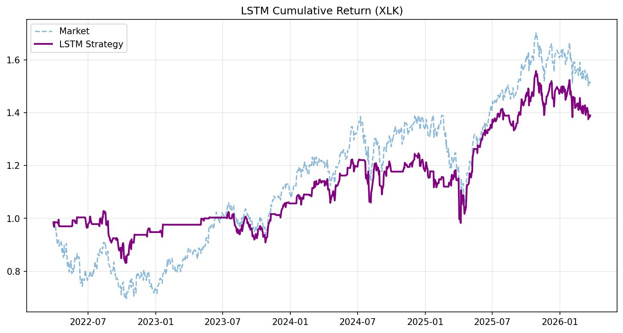
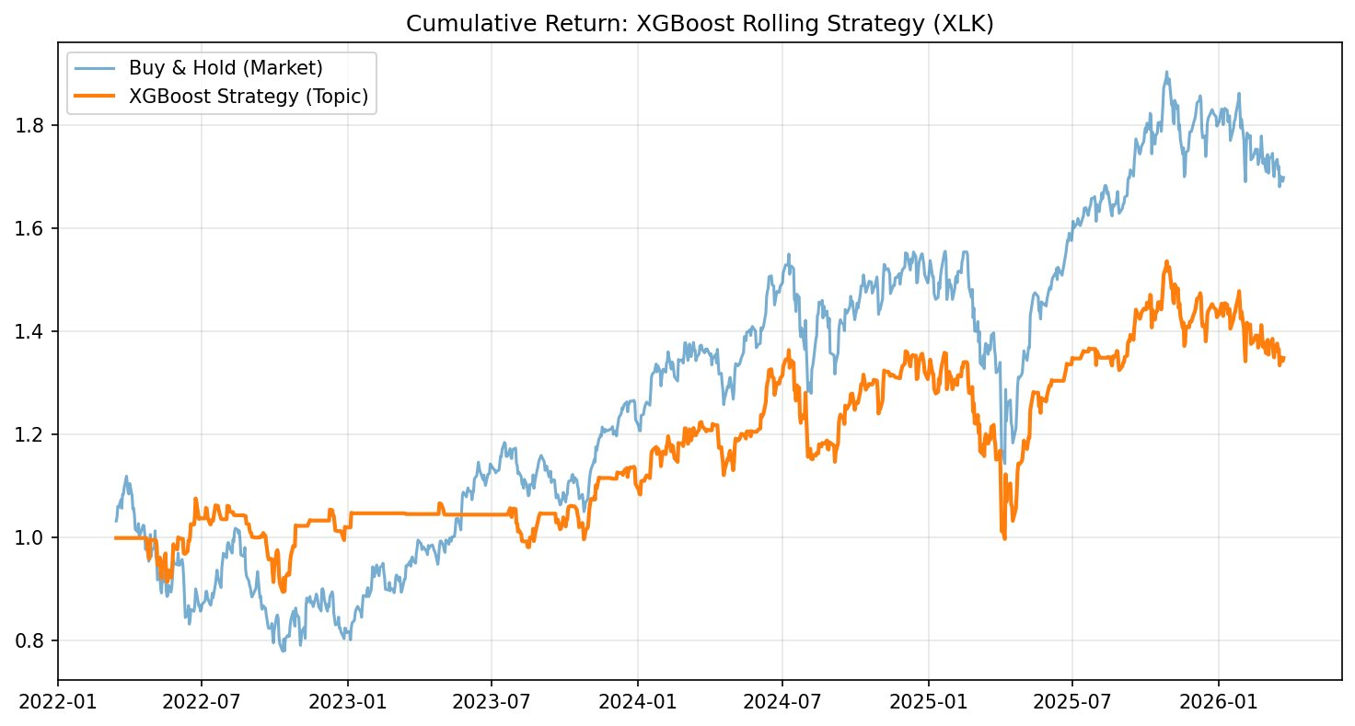
How did the strategy perform?
LSTM Strategy — XLK
XGBoost Strategy — XLK
Honest take: Both strategies underperform buy-and-hold on total return — but directional accuracy stays above random (54.65% vs 50%). The value is in predicting direction, not maximizing absolute return.
7

Slide 8
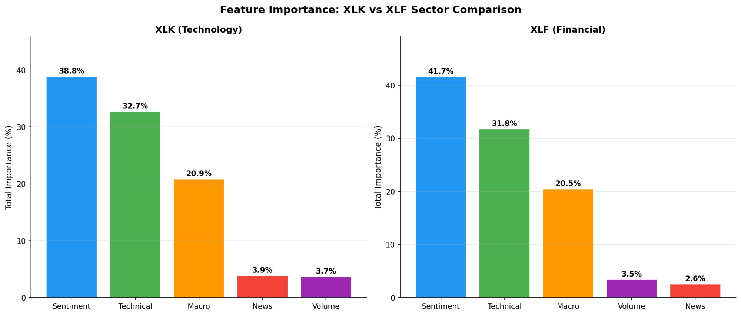
Wait — something strange.
🤔
XLF relies MORE on sentiment (41.7% vs 38.8%) and has more top-10 sentiment features —
but still
predicts worse. Why?
8

Slide 9
The answer: correlation vs causation.
🏦 XLF
📱 XLK
Co-movement
Causal Transmission
Rate decision
Tech news published
Sentiment score
(Day 0)
→ 1–4 days later
XLK price
reacts
News sentiment
⬇ same moment
XLF price
⬇ same moment
No lag to exploit → model learns co-movement,
not causation → Granger: 0 features
Retail investors process news over days
→ Granger: 6 features, lags 1–4 days ✓
"Reliance" in the model ≠ "Predictability" in the market. Granger causality is the diagnostic.
9

Slide 10
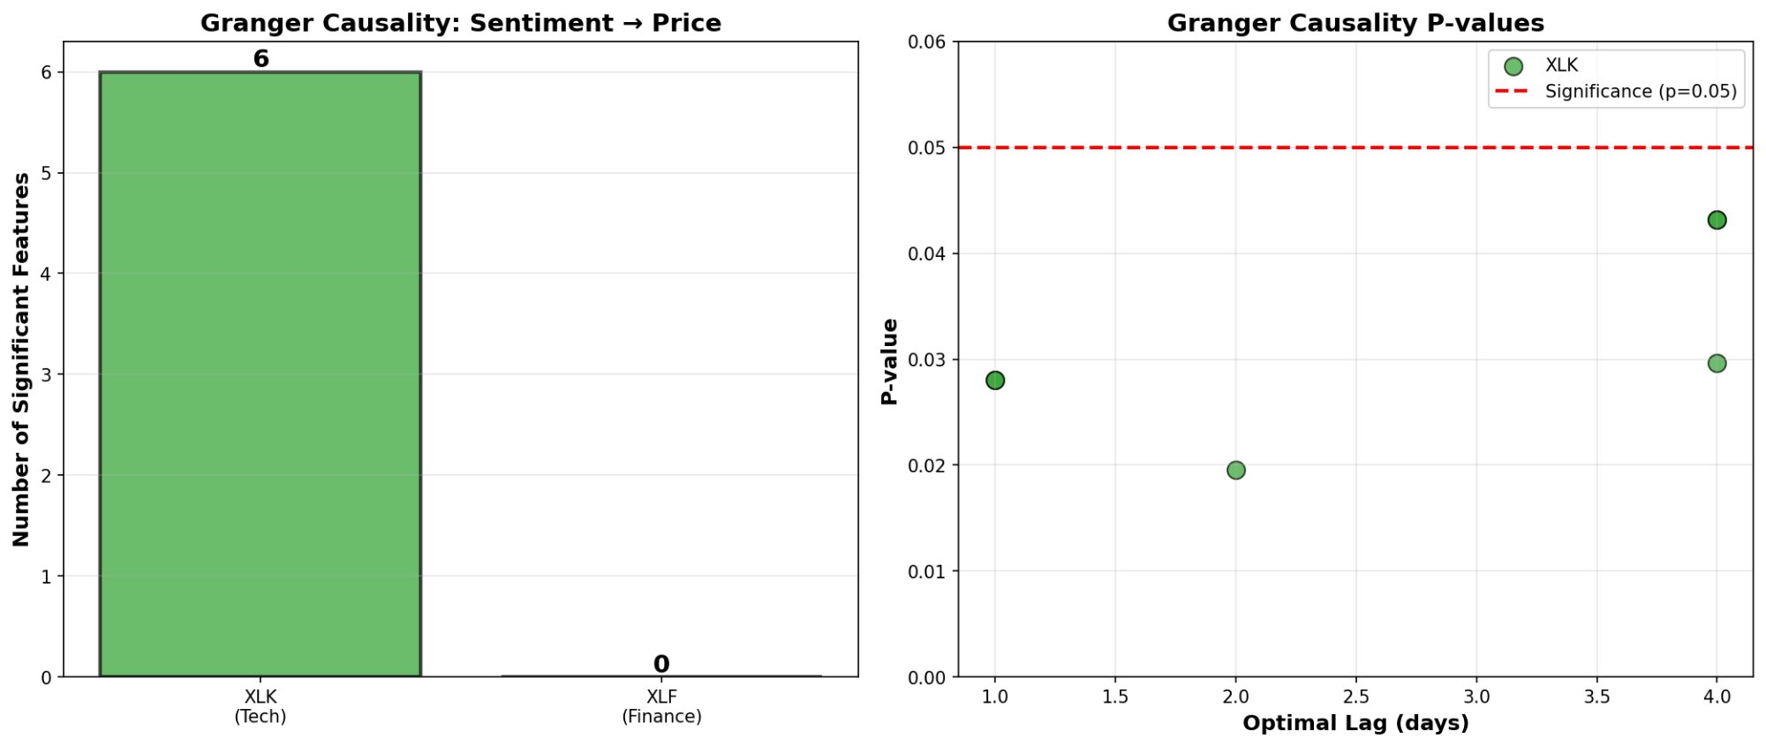
The proof: Granger causality
Does today's sentiment statistically predict price movement in the next 1–5 days?
6
XLK features
significant
(lags 1–4 days)
0
XLF features
significant
(any lag 1–5)
What this means for H1:
Paired t-test: t = 2.747, p = 0.003 (n = 1,010 days) | XLK accuracy gap: +5.94 percentage points
All 4 sentiment models agree: XLK > XLF. Sign test p = 0.0625 (minimum achievable with n=4).
10

Slide 11
But does adding sentiment actually help?
No.
...but that tells us something.
① NYT articles have a 24-hour indexing lag — by the time we score sentiment, the market has already reacted. ② Sentiment features overlap with technical indicators (Bollinger Bands, RSI) — adding them buys little new information.
Not statistically.
(p > 0.12)
The bigger insight:
H1 and H2 don't contradict each other. XLK is more predictable using sentiment signals (H1 ✓) — but removing those signals barely hurts accuracy (H2 ✗). This is because the smoothed / lagged features that drive Granger causality are subtle and get averaged out in the McNemar test across 250 test days.
11

Slide 12
One more twist: ARIMA flips the story.
Without ANY sentiment — just past prices — which sector is more predictable?
XLF wins
Why?
56%
Financial stocks follow rate cycles. The Fed hikes → bank margins expand → XLF rises. These cycles are slow, predictable, and already baked into past prices.
Tech stocks react to
surprises — earnings beats, product launches. Past prices tell you nothing until the news hits.
ARIMA accuracy
(XLK = 48%)
The complete picture:
XLF = structurally predictable from time series | XLK = conditionally predictable from sentiment
Both sectors have a predictability edge — just from completely different sources.
12

Slide 13
From Research to Real-World Signal
Live pipeline run on Apr 9, 2026 close — demonstrating end-to-end inference capability
📱 XLK (Technology)
🏦 XLF (Financial)
SELL
SELL
39.2% bullish probability
21.8% bullish probability
Top driver: MA10 + Sentiment_Price_Divergence
Top driver: Volume_Ratio + BB_Lower
Pipeline generated next-day signals within seconds of market close — from raw news sentiment to actionable output. Code available at: github.com/yeyouya2-eng/News-Sentiment-Stock-Prediction
13

Slide 14
Limitations and Fair Comparison
⏰ 24-Hour NYT Indexing Lag
By the time sentiment is scored, the market has already reacted. This explains H2 rejection — but does NOT affect Granger (which tests lags of 1–4 days, beyond the lag window).
⚠ Data Imbalance — Not a Fully Fair Comparison
XLK: 2,600 articles vs XLF: 484 articles. XLF's lower accuracy may partly reflect weaker training signal, not absence of sentiment effect. Equivalent volumes (e.g., adding Bloomberg/Reuters) needed for a fully fair comparison.
📖 LM Dictionary — Not an Absolute Ground Truth
Keyword-based labels cannot detect sarcasm or contextual nuance. Future work: human annotation or cross-model LLM voting for ground truth validation.
These limitations are acknowledged — and do not invalidate the core H1 finding or Granger mechanism.
14

Slide 15
What did we learn — and what should you do?
📊 4 Research Findings
💡 3 Practical Implications
📡 Tech sentiment: real but short signal
Retail investors process tech news over 1–4 days. That window is real, measurable, and statistically confirmed (t=2.747, p=0.003).
📱 Retail investors — Tech (XLK)
The 1–4 day sentiment lag is real and exploitable. Reading NYT tech news gives you an informational window before prices fully react. → Use sentiment for entry timing.
🔗 Finance sentiment: passenger, not driver
XLF uses sentiment heavily in its model — but news and prices move together. High feature importance ≠ predictive power.
🏦 Retail investors — Finance (XLF)
Institutional algorithms price in XLF news within milliseconds. The window closes before retail investors can act. → Stick to macro cycle signals.
🏛 Markets mostly (but not perfectly) efficient
H2 rejection confirms sentiment is largely priced in within a day. The 24-hr NYT lag seals most of the signal — but not all of it.
💼 Quant funds & NLP teams
Deploying NLP on macro-coupled sectors produces high feature importance without causal predictive power — wasted compute. → Direct NLP resources to event-driven sectors.
🔍 Granger causality is the key diagnostic
Separates “correlated in the model” from “causally predictive in the market” — a distinction that changes the entire interpretation.
Sector structure determines whether sentiment is a signal — or just noise.
15
YE, Yongyi | 25402137 | ECON 7055 | April 2026
15

Slide 16
Appendix 1 — Full Results & Statistical Tests
Reference slide — open if asked during Q&A
A. Full Model Performance Summary
Model XLK Acc XLF Acc XLK Sharpe XLF Sharpe Days Cost
XGBoost ★ 54.65% 48.71% +0.47 -0.29 1,010d 0.1%
LSTM 53.50% 50.00% +0.52 +0.29 1,000d 0.1%
Logistic Reg. 50.99% 50.59% -1.10 -0.53 1,010d 0.1%
Random Forest 51.39% 46.73% -0.98 -0.72 1,010d 0.1%
ARIMA(5,1,0) 48.00% 56.00% N/A N/A Last 100d —
B. Granger Causality — XLK Significant Features
C. H2 McNemar Test Results
Feature Lag p-value
Sentiment_LM / _Raw 4d 0.0432
Sentiment_MA3 2d 0.0196
Sentiment_MA10 4d 0.0296
Sentiment_Vol / _Std10 1d 0.0281
All XLF features (11) — > 0.05
Sector Model Baseline Full Δ p-value
XLK XGBoost 55.05% 53.17% -1.88pp 0.1213
XLF XGBoost 49.70% 48.81% -0.89pp 0.5065
XLK LSTM 47.64% 54.08% +6.44pp 0.1636
XLF LSTM 55.79% 52.36% -3.43pp 0.3960
16

Slide 17
Appendix 2 — Hyperparameters & Pipeline Configurations
📊 Sentiment Pipeline Params
Pipeline 1 — Sparse NB Pipeline 2 — Dense SVM ★ WINNER
TF-IDF max_features=3000, ngram=(1,2), NB alpha=1.0 TF-IDF max=5000 → SVD n=100 → SVM C=1.0, kernel=rbf
Pipeline 3 — LDA + XGBoost Pipeline 4 — Word2Vec + XGBoost
TF-IDF → LDA n_topics=30, XGB max_depth=3, lr=0.1 W2V vector=100, window=5 → XGB max_depth=3, lr=0.1
⚙️ XGBoost Best Params (from GridSearchCV)
🧠 LSTM Best Params
max_depth=5 | learning_rate=0.05 | n_estimators=200 | subsample=0.8 | colsample_bytree=0.8 | gamma=0 | CV: TimeSeriesSplit(n=3) | Retrain every 20 days | Train window: 252 days
units=64 | dropout=0.2 | lookback=10 days | batch=32 | lr=0.001 | Early stopping patience=3 (val_loss) | 20% validation split | Retrain every 126 days
Full implementation available at: github.com/yeyouya2-eng/News-Sentiment-Stock-Prediction | Full methodology: Report Section 2.3–2.5
17

